Slide 1
Romancing Erotic Labor - Logistics
INTIMACY in the SEXx INDUSTRY
M. DANTE

Slide 2
SEXX Talk
"... the most amazing thing about sex work for me has been going in to it with all this anger at men and modern constructs of pornified/commodified sexuality - and then finding that when two strangers truly get naked in a room together - the result is often beautiful, vulnerable, life-affirming, exploratory, and unique (I think) to sex work”. (Love. 2015)

Slide 3
SEXx Vocab
Currently - in the media and law enforcement –
men who pay to interact with sex workers
are defined as:
johns
perps
pervs
tricks
They are sex buyers.
Notes:
Image: http://euranetplus-inside.eu/prostitution-targeting-the-sex-buyers/

Slide 4
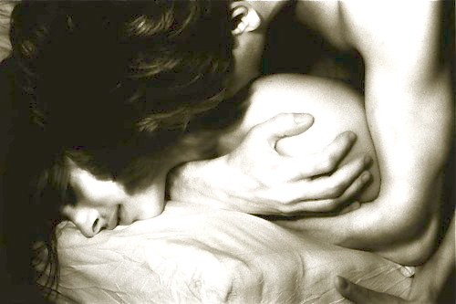
SEXx Vocab
Sex buyers pay sex workers for a form of
sexual interaction or intimacy.
Notes:
Image: http://www.elephantjournal.com/2014/01/6-ways-to-have-radically-intimate-sex-zoe-kors/

Slide 5
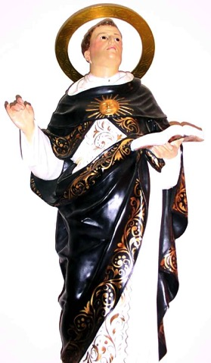
prostitution is not a new phenomenon
Prostitution thrived in Medieval times and was generally ignored by the Church, or at worst considered a necessary evil, as scholar and saint, Thomas Aquinas thought:
If prostitution were to be suppressed,
careless lusts would overthrow society.
Most towns had a brothel.
http://dangerousminds.net/comments/a_handy_guide_to_sex_in_the_middle_ages
Notes:
Image: http://www.stthomasaquinasparish.org/webpics/stthomas.jpg
Quote: http://dangerousminds.net/comments/a_handy_guide_to_sex_in_the_middle_ages

Slide 6
SEXX ACTS
Very different from the view of Saint Thomas
In 1908 the United States committed to an international agreement for the repression of trade in white women.
This was known as the “White-Slave Traffic Act”.

Slide 7
SEXX ACTS
Passed by the Sixty-First Congress on June 25, 1910:
CHAP. 395 — An Act to further regulate interstate commerce and foreign commerce by prohibiting the transportation therein for immoral purposes of women and girls, and for other purposes.
The White-Slave Traffic Act became known as
The Mann Act

Slide 8
SEXX ACTs
The Mann Act – which never caught any slave traders - has never been repealed.
In 1978, Congress updated the definition of "transportation" in the act, and added protection for minors of either sex against
commercial sexual exploitation.
A 1986 amendment further protected minors and added protection for adult males, and replaced "debauchery" and "any other immoral purpose" with "any sexual activity for which any person can be charged with a criminal offense.”
http://www.pbs.org/unforgivableblackness/knockout/mann.html

Slide 9
More Sexx acts
Here we are in 2015 with a new set of trafficking laws intact:
Since 2000 the Trafficking Victims Protection Act (TVPA) has been
enhanced and enforced as the Trafficking Victims Reauthorization Act
2003, 2005, 2008 and 2013.
Since 1994 the Violence Against Women Act (VAWA) has been addressing controversial global issues, expanding as the Violence Against Women Reauthorization Act 2000, 2005, 2012, and 2013.

Slide 10
More Sexx acts
The Trafficking Victims Protection Act (TVPA) of 2000 created the first comprehensive federal law to address human trafficking, with a significant focus on the international dimension of the problem.
VAWA 2013 covers serious international situations including:
Acid throwing, Breast ironing, Bride burning, Date rape, Domestic violence, Dowry death, Honor killing, Female genital mutilation, Female infanticide, Femicide, Foot binding, Forced abortion, Forced marriage, Forced pregnancy, Forced prostitution, Genocidal rape, Human trafficking, Murder of pregnant women, Rape, Pregnancy from Rape, Sati (or the suicide of a widow by fire), Sexual slavery, Sexual violence, and Violence against prostitutes.
Notes:
TVPA from www.polarisproject.org

Slide 11
Wait, What?
Mutually consensual prostitution
“Sex Work”
is currently interpreted as a facet of
Human or Sex trafficking.

Slide 12
Wait! What?
The concept of mutually consensual adult erotic labor has become vilified in the media and law enforcement, with every and any exchange defined as a form of sex trafficking.
This is potentially dangerous to women who identify as Sex Workers.
Notes:
http://sexworkersproject.org/media-toolkit/downloads/05-HumanTraffickingAndSexWork.pdf

Slide 13
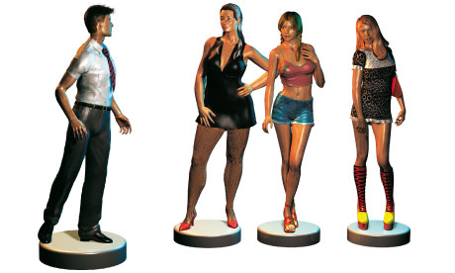
Wait! What?
This - I believe - inaccurately defines trafficking,
Inspiring me to contemplate how I view men who interact with sex workers
Notes:
http://static.guim.co.uk/sys-images/Guardian/Pix/pictures/2011/8/3/1312366607391/Sex-workers-and-clients-i-008.jpg

Slide 14
SECRET SEXX TALK
I identify as a Sex Worker!
Sex Work has defined my female gender and sexuality more than any other term, and has also challenged my views on gender identity, sexuality, spirituality, and the importance of connectivity & intimacy.
Photograph of M. Dante courtesy of Marcos Adrian Villas NYC 2004

Slide 15
Secret sexx talk
I do not debate that there are many hazards being
a commercial commodity.
My interactions with men defined as sex buyers have culminated
- I believe – into a comforting place of compassion:
Towards others and also myself.

Slide 16
Sexx talk
By experiencing a plethora of scenarios - good and bad - I have the luxury of establishing baselines for what I perceive to be fair levels of interaction with:
johns
perps
pervs
tricks
Only I rarely call the men with whom I share intimacy by those names.

Slide 17
Sexx talk
The people who work with me usually consider me their:
guide mentor erotic intimate anonymous friend lover
Because regardless of the reality of the commercial exchange,
we are also sharing an experience, or series of experiences.

Slide 18
Shared sexx talk
The experience/s shared may be role play, dominance, submission, sensate focus, massage, friendship, oral or penetrative sex, sexual surrogacy, intimacy training, or simply sharing time to discuss topics taboo or slightly strange or shamed.
Sometimes commercial sexual experiences are
unexpectedly touching in the anonymity.
A universally, mutually understood RELIEF!

Slide 19
Shared sexx talk
My goal here is to inspire you – My audience - to contemplate the current language prevalent in the media about
the sex industry, sex workers & sex buyers.
There is a difference between the naughty and the nefarious,
the curious from the clinical;
No - not all sex buyers are pathological perverts.
They aren’t all johns.

Slide 20
SEXX RIGHTS
There CAN be
Intimacy in the SEX industry!
It starts by choosing to participate in the conversation of why sex workers may be valid for: a one time experience; as temporary, or semi permanent companions; for a myriad of scenarios & solutions.
Maybe even one that involves you!
I support the Erotic Service Provider Legal Educational Research Project
http://esplerp.org/

